Slide 1

GAS LEAKAGE DETECTION WITH ARDUINO USING IOT
DEPARTMENT OF COMPUTER SCIENCE AND ENGINEERING
BATCH NO:15IOT07
GUIDED BY:
Dr.K.Vijaya Sri
Associate Professor (C.S.E)
BATCH MEMBERS: I.L.Nagaraju -150030334
K.Mounika -150030497

Slide 2
CONTENT
ABSTRACT.
INTRODUCTION.
EXISTING PROBLEM.
PROPOSED SYSTEM.
BLOCK DIAGRAM.
AIM AND OBJECTIVE.
CONCLUSION.
REFERENCES.

Slide 3
PLAN OF ACTION
S.NO | WEEK | WORK TO BE DONE
1 | WEEK-1 | Gathering of base papers related to project and working on them.
2 | WEEK-2 | Understanding the base paper and preparing abstract.
3 | WEEK-3 | Gathering of components required and work on those components.
4 | WEEK-4 | Implementation of module/project.
5 | WEEK-5 | Implementation of module/project.
6 | WEEK-6 | Testing the project module.
7 | WEEK-7 | Finalizing of project and documents

Slide 4
ABSTRACT
Today, Technology has not merely established our lives simpler, but also offers a high level of safety and security wherever required.
In our day to day lives, we all use cooking fuel for cooking our daily meals, but if this fuel gets leaked due to some or the other way, and then there is a large possibility of a calamity to occur around.
Hazards due to gas leakage are dangerous and can become uncontrollable if timely actions are not taken.
But this gas leak mostly remains unnoticed and there should be some means to observe them so that a quick action can be brought.
The gas leak sensor is such a device which detects the gas leaks at initial levels and warns the people of the same.
This will basically deals with the development of a simple gas leak detector at the initial stage and then transforming this simple device into a most advanced gas detector system in the future.

Slide 5
INTRODUCTION
Gas leakage can become a disaster which results in various accidents resulting into both financial loss as well as human injuries.
In India, where cooking gas is made available in steel canisters, this type of mishap can happen frequently. To solve this problem, we can make a gas leakage detection monitor with IOT.
This project will use a simple MQ6 sensor. Gas leakage detection monitor using IoT will alert the user over network about the gas leakage using sms or phone call.

Slide 6
EXISTING PROBLEM
Nowadays accident occur due to LPG leakage is very common. When the main regulator valve remains open, the LPG leakage gets start.
The risk of firing, explosion, suffocation all are based on their physical properties such flammability, toxicity etc. The number of deaths due to the explosion of gas cylinders has been increasing in recent years.
The reason for such explosion is due to sub standard cylinders, old valves, worn out regulators and lack of awareness using gas cylinders add to the risks.
There is a need for a system to detect and also prevent leakage of LPG which results in various accidents resulting into both financial loss as well as human injuries.

Slide 7
PROPOSED SYSTEM
The proposed system is used to take an automatic control action after the detection of 0.001% LPG leakage by MQ6 sensor.
when the gas leakage is detected, alert message send to the owner by using GSM module
This automatic controlling will send the signal to the buzzer and buzzer start beeping.
Exhaust fan gets switch on which help to decrease the concentration of gas in the particular room.

Slide 8

BLOCK DIAGRAM
Power supply
LPG gas sensor
Arduino Uno
Or
Micro controller
LCD
Buzzer
GSM module
SMS alert
or
Phone call
Switching exhaust fan

Slide 9
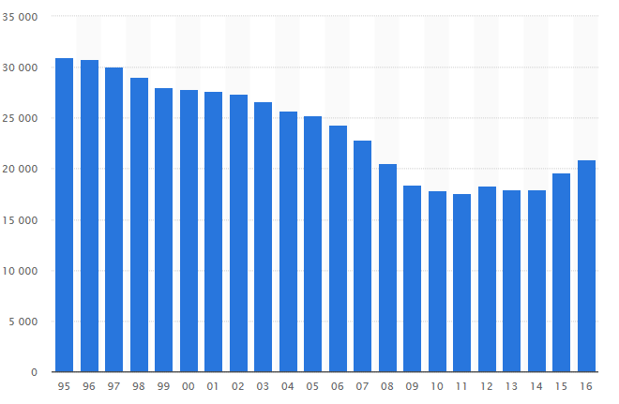
AIM AND OBJECTIVE
To reduce number of accidents that are caused due to gas leakage every year and provide safety environment.
Improve the present system and make it even better and reliable
The adjacent figure shows the statistical analysis of accidents that are caused by gas leakage.

Slide 10
Conclusion
The system provides control action by buzzer alarm and after that the system sends a alert message to the user within short time of leakage.
It has more advantageous function than the existing problems thus the real-time automatic approach.
This monitoring and detection system is proposed mainly to meet the safety standards and to avoid fire accidents because of leakage.
Hence, Gas leakage detection is essential to prevent accidents and to save human lives.

Slide 11
References
https://www.ijraset.com/fileserve.php?FID=9021 “Gas Leak Detector using Arduino UNO Microcontroller”- Mr. Akshay D. Prabhu1 , Mr. Ashwin D. Pathak2
http://ijcrt.org/papers/IJCRT1801265.pdf ”Detection of Liquefied petroleum gas using sensor through arduino uno microcontroller”-Aastha Singh1 , Mr. Manish Verma2 , Mr. Lumesh Sahu3
“Gas Leakage Detection, Alerting and Monitoring using IoT”-Utkarsh Bharade1 , Vineet Jain2, Sourabh Chavan3

Slide 12

THANK YOU....

